Slide 1

PREPARED BY: HURLEY EVANGELISTA | EMMANUEL DEVERA|
ALYSSA FERNANDEZ | MIGUEL MATAWARAN
Notes:
Good Afternoon po Sir and Miss. I am Alyssa Fernandez and these are my groupmates, Hurley, Emmanuel, and Miguel and we’re Team Dash-R-Come.

Slide 2
RECAP
File size limitation
Remove confirmation when creating emergency call
Plan your presentation
Extend scopes (do not limit to motorists only)
Consistency and being specific

Slide 3

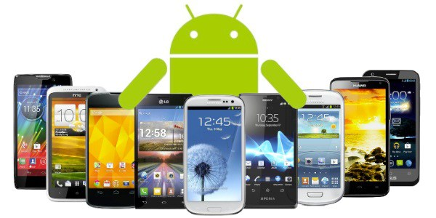






Notes:
Alyssa? Dash-R-Come is an Incident Reporter System that runs in Android devices and aims to help the Users to generate an Incident Report using the applications features and the Agency to get a detailed report for them to be able to respond to the User. As well as, for the both parties to have an evidence, statistics to future use. Project Scope are the places in Makati City and target Agency is Barangay Magallanes.

Slide 4
OBJECTIVES
To expand the scope of Pilipinas 911 services in terms of receiving incident reports.
To provide the client real-time and detailed incident reports.
To provide the client records of incident that occurs monthly.
To provide evidence or supporting details when reporting an incident to the client.
To provide evidence that can help the user in future use. (e.g. Dishonesty of the latter to the his/her fault)
Notes:
Mico: to help expand the scope of Pilipinas 911 in receiving incident report
To provide real-time and detailed incident report
Provide client records that occurs monthly
Provide supporting details when reporting an incident to the client
Provides evidence that help user for future references

Slide 5
FEATURES
Login system feature to authenticate the user and to avoid fake reporters.
A third party video cutter feature to reduce the file size and data that will be consumed.
'Take a snap' feature that allows user to send only a picture of an event.
'DashBlue' feature that allows user to transfer the video footage of the incident from the dashboard camera to the android device.
30 seconds limitation for capturing to video footage to reduce the memory used.
Notes:
Alyssa

Slide 6
SCOPE AND LIMITATIONS
Motorists, bystanders, constituents and android device users
Mobile Data / Wi-Fi Connection
Third- party program
Android device / Dashboard camera
Dashboard camera to Android device
Not cover responding
Notes:
Emman

Slide 7
SOFTWARE REQUIREMENTS SPECIFICATION (SRS)
Output
✓ The mobile application will display a message if the user has successfully registered to the mobile application
✓ The mobile application’s database shows the list of registered users
✓ The mobile application will display a message if the user has successfully sent the video to the web server.
✓ The agency must send feedback to the user
✓ The employee monitoring the web server must leave a comment to the picture/ video he/she has validated
Notes:
Harl

Slide 8
SOFTWARE REQUIREMENTS SPECIFICATION (SRS)
Input
✓ The user must be connected to Wi-Fi or Mobile data to open the mobile application
✓ The user must have a video to be sent to the agency
✓ Each input field must be complete. Such as, name, contact number, and email address
✓ The user can cut the video using the mobile applications’ feature
✓ The user can transfer the video captured using a dashboard camera to the android device
✓ A confirmation window to provide the user a confirmation of his/her action.
Notes:
Emman

Slide 9
SOFTWARE REQUIREMENTS SPECIFICATION (SRS)
Process
✓The user must be connected to the internet or mobile data
✓The user has to register to use the mobile application
✓The user must upload the video footage/ picture of an incident filmed using android device or dashboard camera to the web server
✓ The employee assigned to the web server will identify the type of incident that was uploaded to the web server[Fire, crime, road accident, unforeseen event]
✓ The employee assigned to the web server will generate an incident report which will be forwarded to the desired agency
Notes:
Mico

Slide 10
SOFTWARE REQUIREMENTS SPECIFICATION (SRS)
Performance
✓The device must be an android device with a Operating System (OS) minimum of Kitkat.
✓The system must be online 24/7
✓ The system must be responsive
Notes:
Anne

Slide 11
SOFTWARE REQUIREMENTS SPECIFICATION (SRS)
Control
✓ The system must provide a login system to avoid prank reporters [RV1] and the login should take 15-30 seconds.
✓ The system must maintain user integrity.
✓ The user must allow the camera, Bluetooth, cellular data and Wi-Fi connection permission for the mobile application.
✓ The users must read the play store policies against the potential harmful or threat party software.
Notes:
Mico

Slide 12
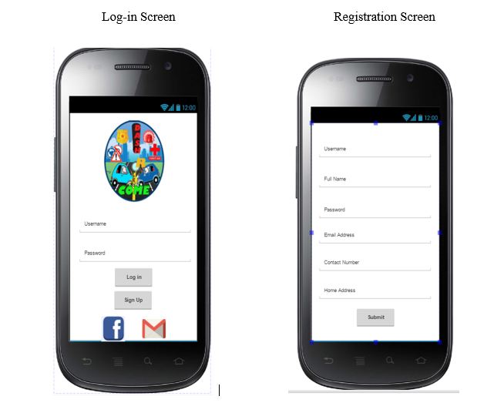
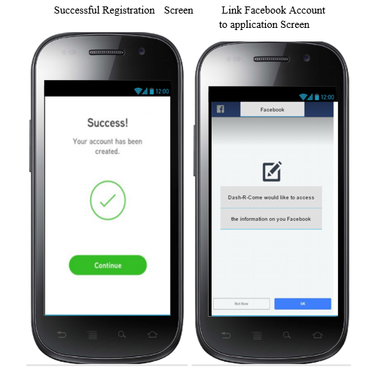
Notes:
Emman

Slide 13
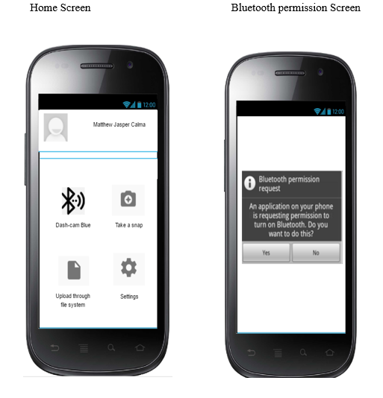
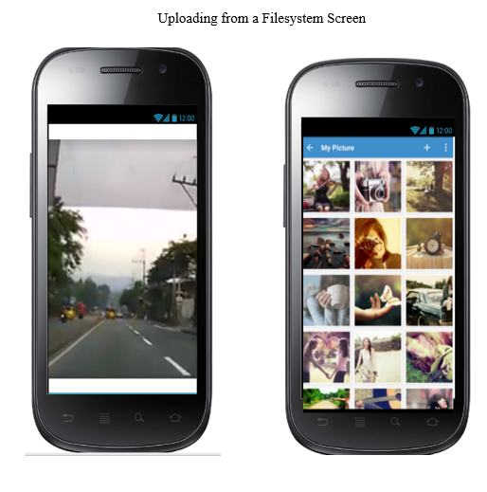
Notes:
Emman

Slide 14
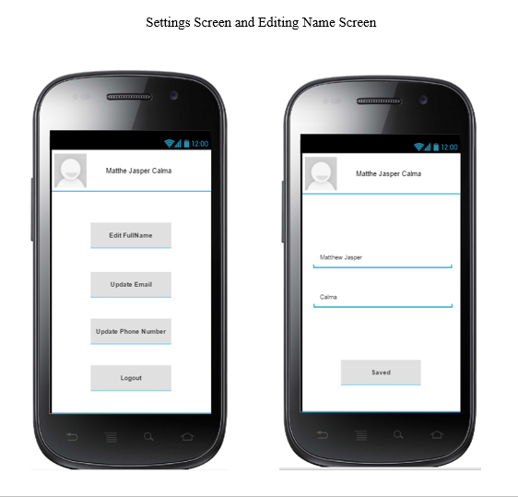
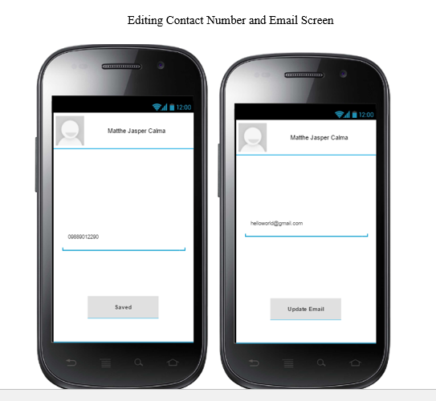
Notes:
Emman

Slide 15
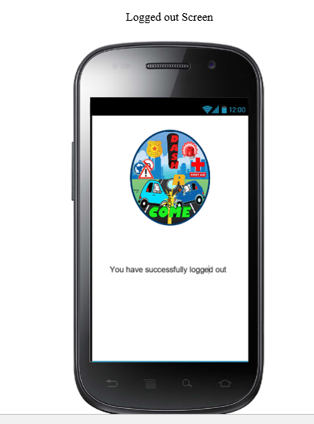
Notes:
EMman

Slide 16
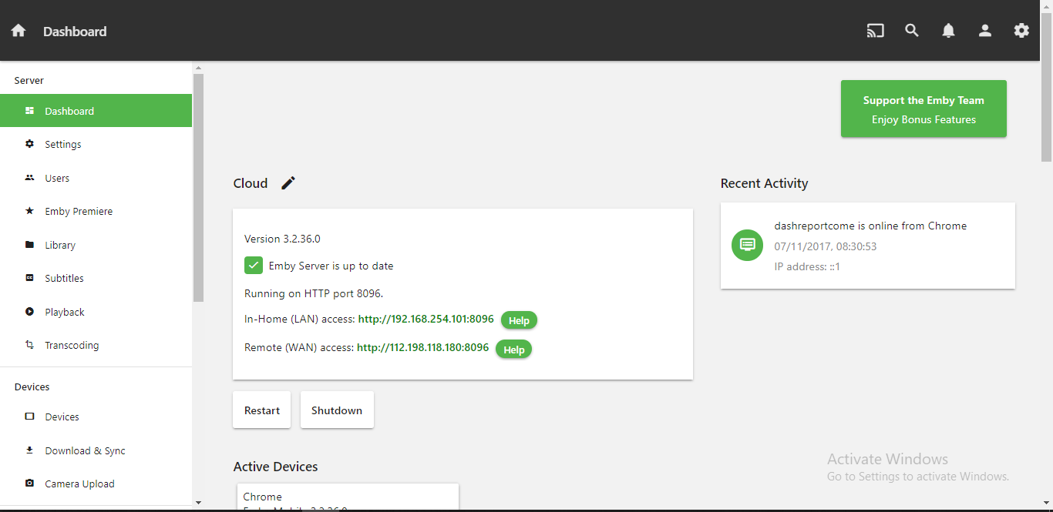
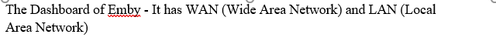
Notes:
Emman

Slide 17
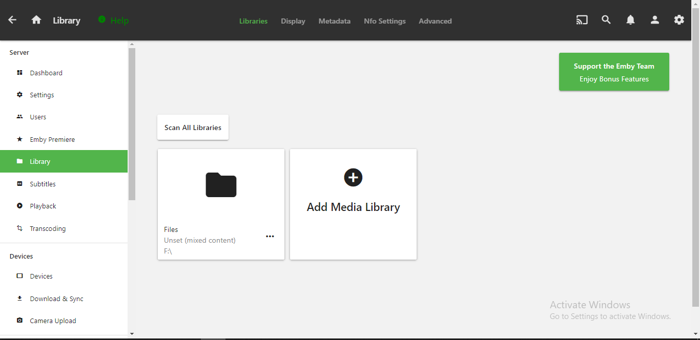
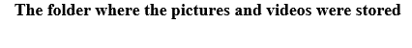
Notes:
Emman

Slide 18
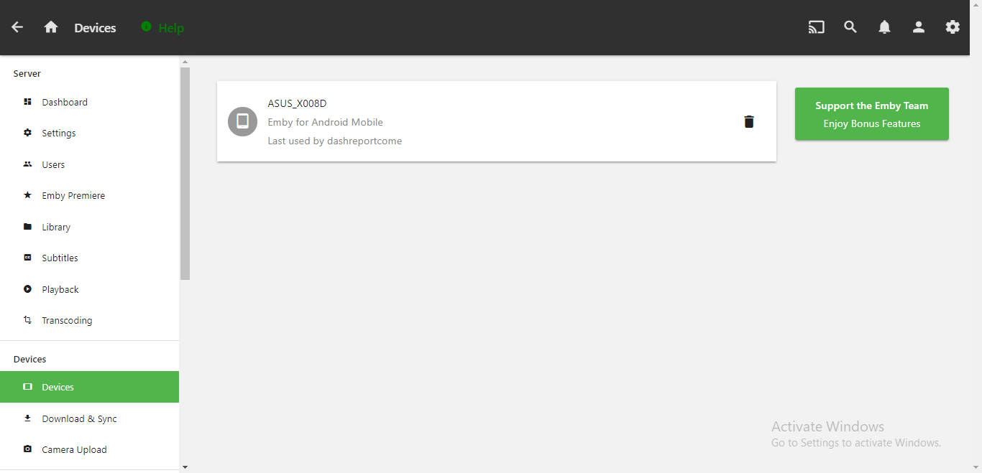
Notes:
Emman

Slide 19
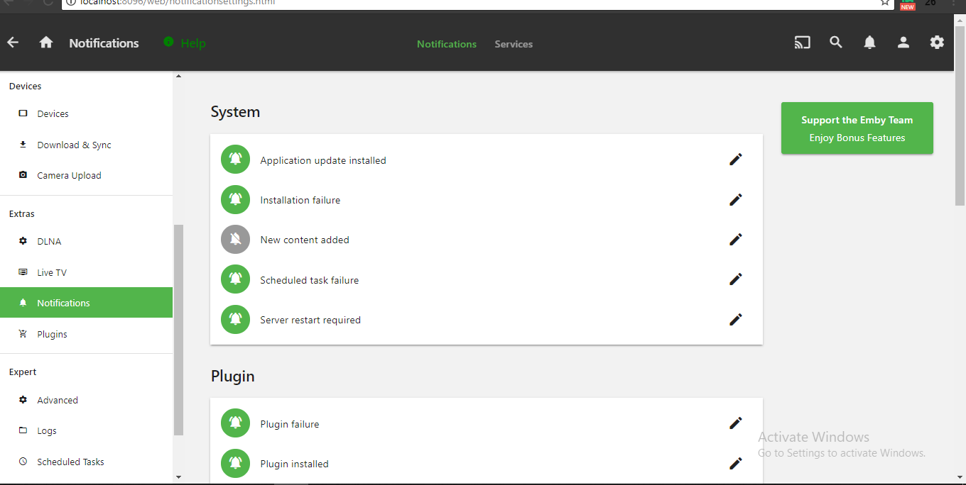
Notes:
Emman

Slide 20
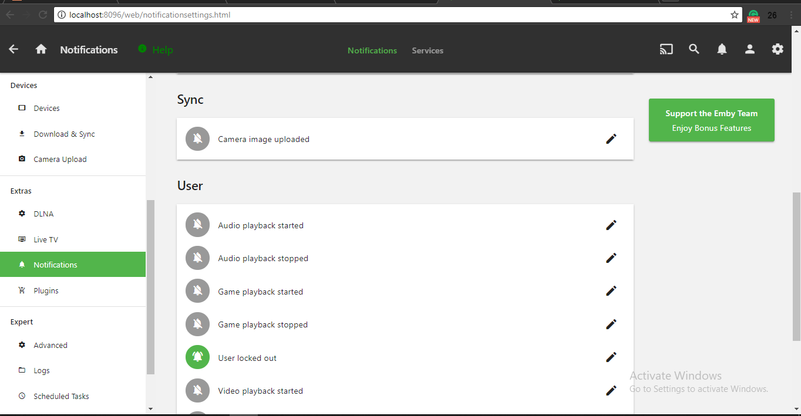
Notes:
EEmman

Slide 21
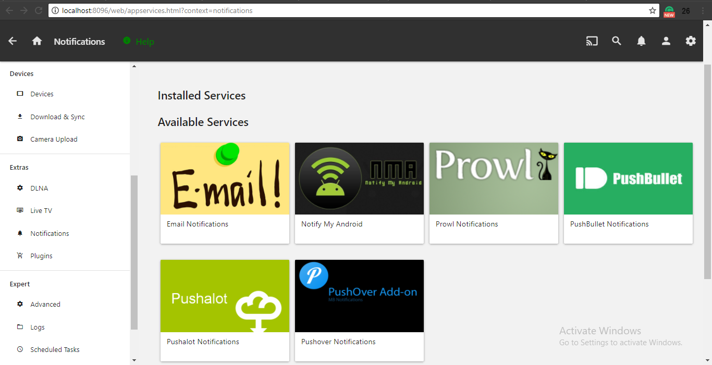
Notes:
Emman

Slide 22
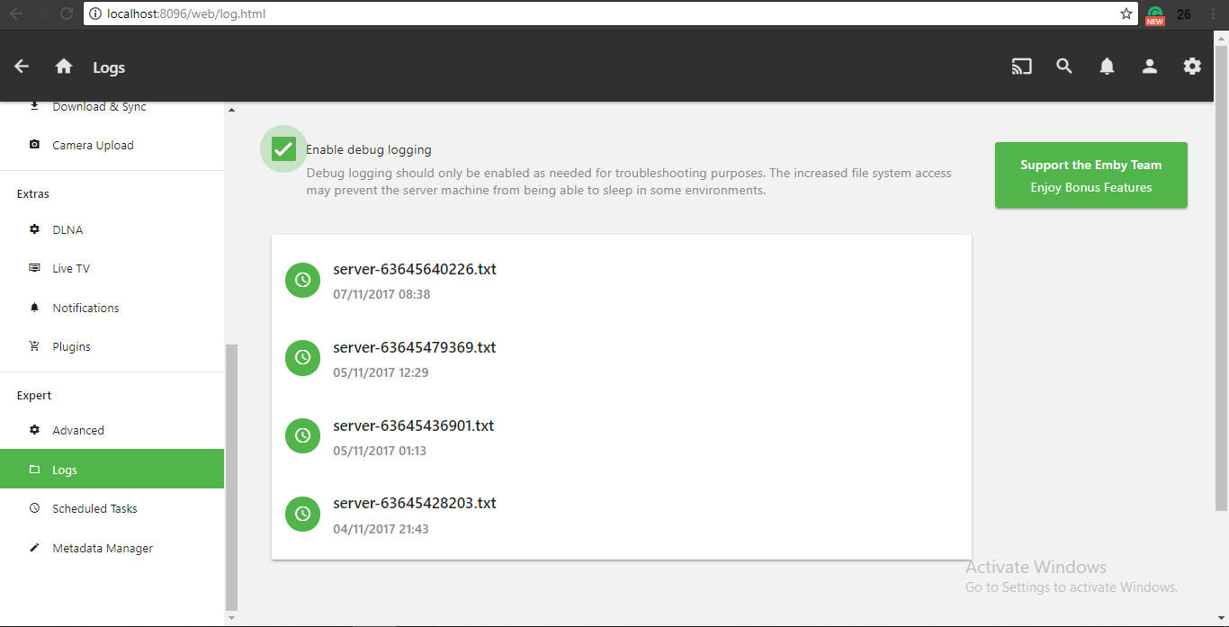
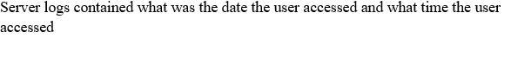
Notes:
Emman

Slide 23
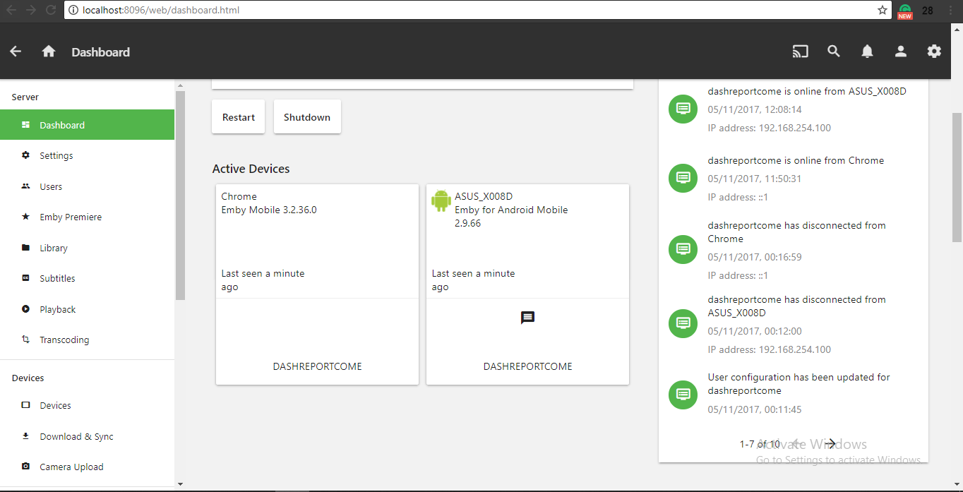
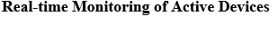
Notes:
Emman

Slide 24
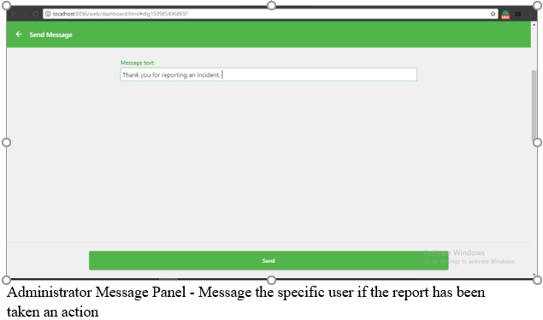
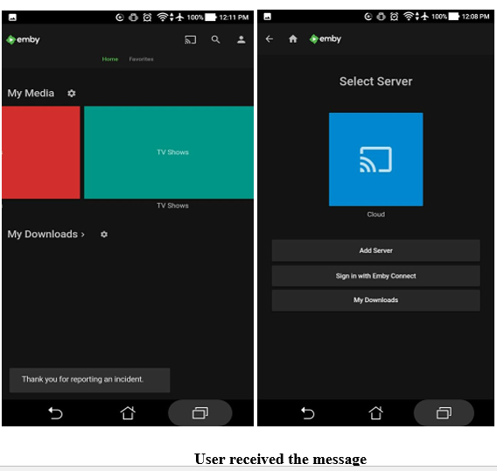
Notes:
Emman

Slide 25
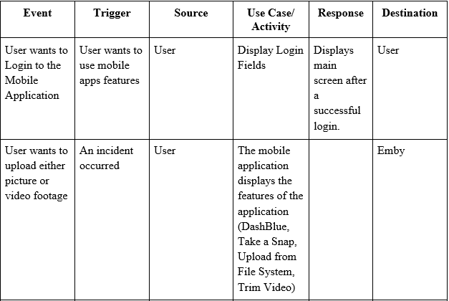
EVENT TABLE
Notes:
Harl

Slide 26
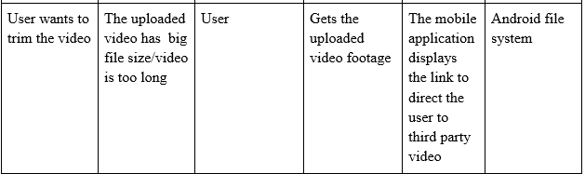
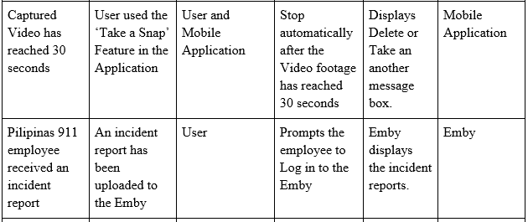

Slide 27
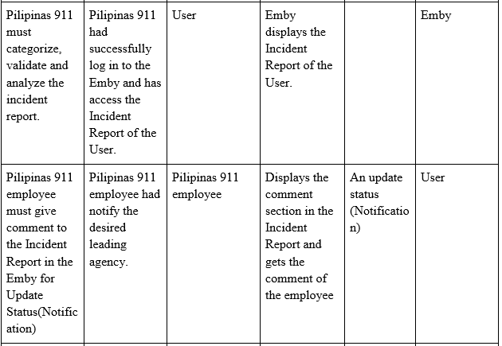

Slide 28
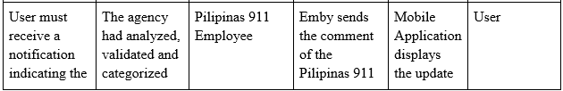
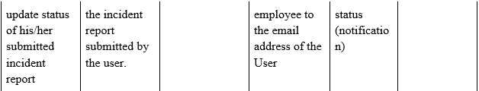

Slide 29
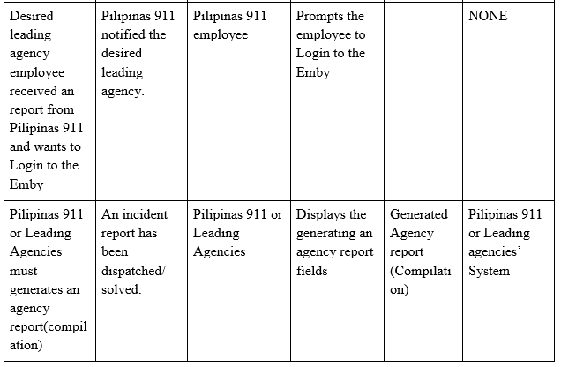

Slide 30
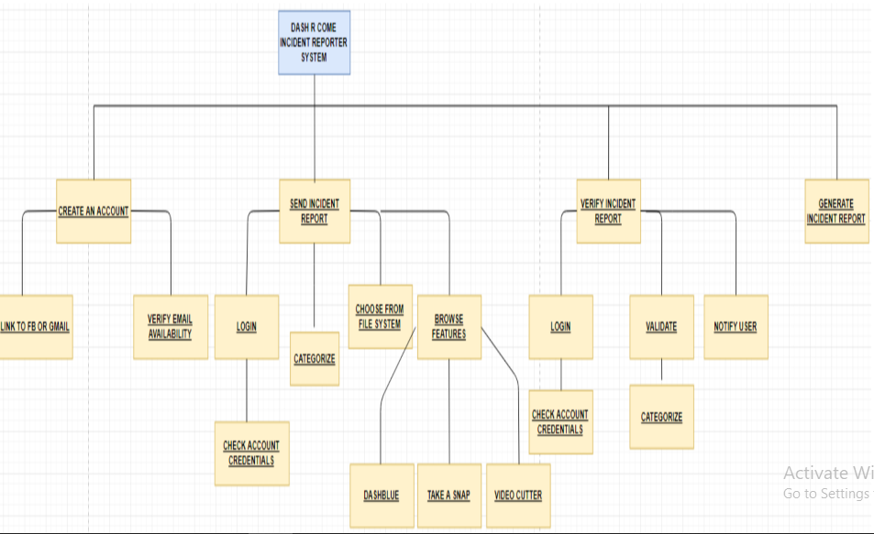
FUNCTIONAL DECOMPOSITION DIAGRAM
Notes:
Anne

Slide 31
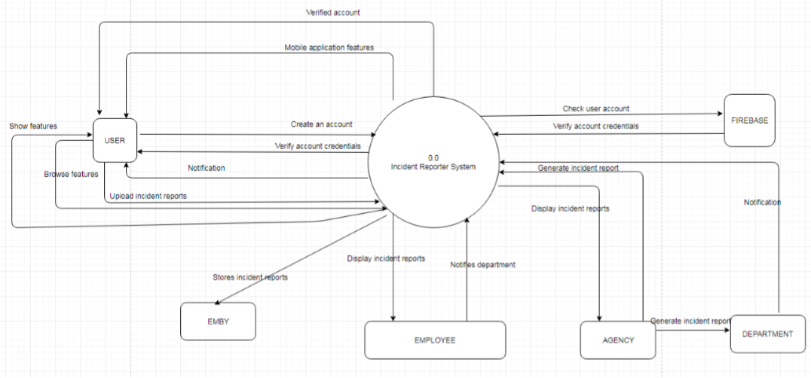
DATA FLOW DIAGRAM: Level 0 Diagram
Notes:
Mico

Slide 32
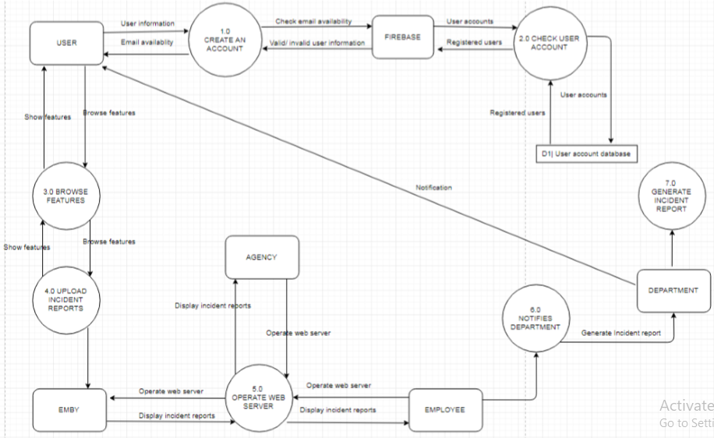
LEVEL 1 DIAGRAM
Notes:
Mico

Slide 33
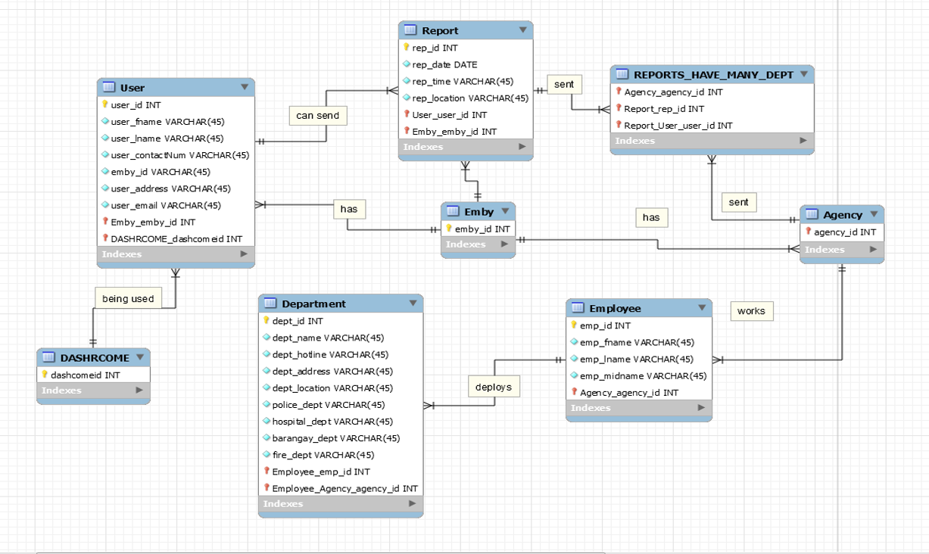
ENTITY RELATIONSHIP DIAGRAM
Notes:
Harl

Slide 34
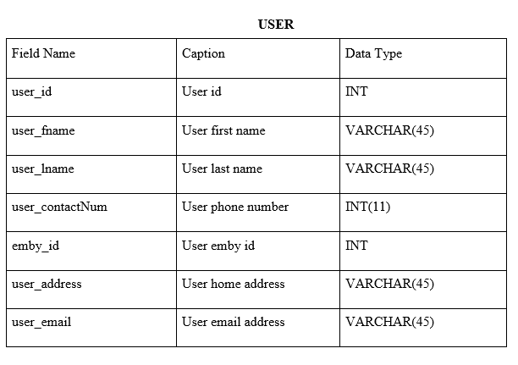
DATA DICTIONARY

Slide 35
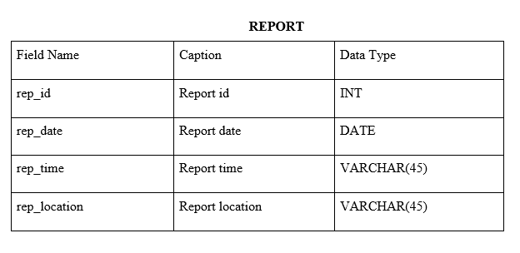
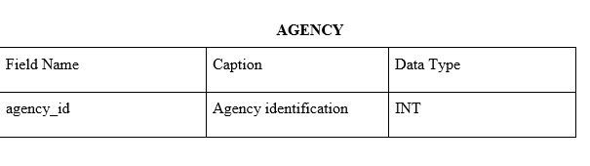
DATA DICTIONARY

Slide 36
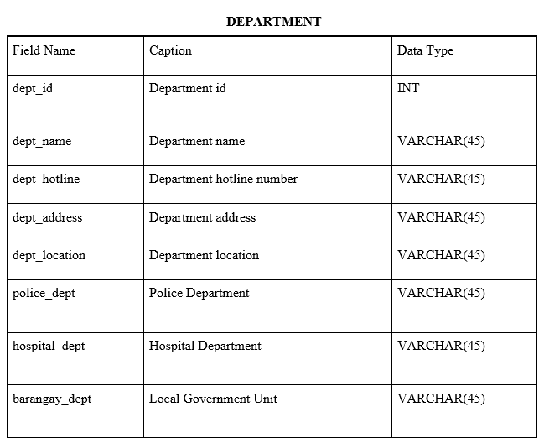
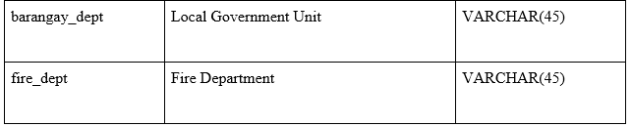
DATA DICTIONARY

Slide 37
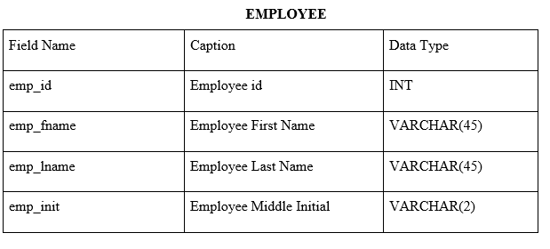
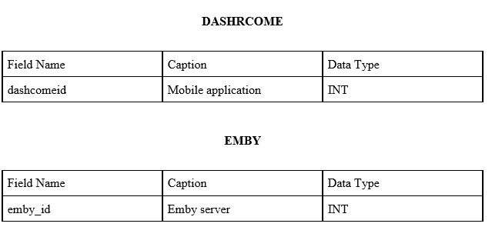
DATA DICTIONARY

Slide 38
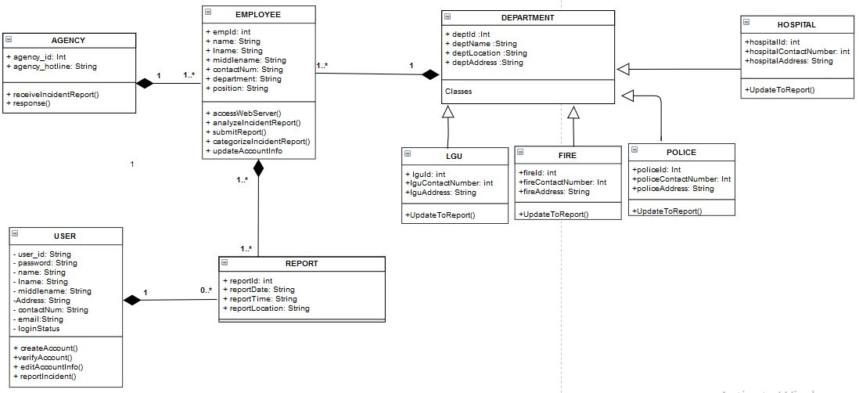
Class Diagram
Notes:
Harl

Slide 39
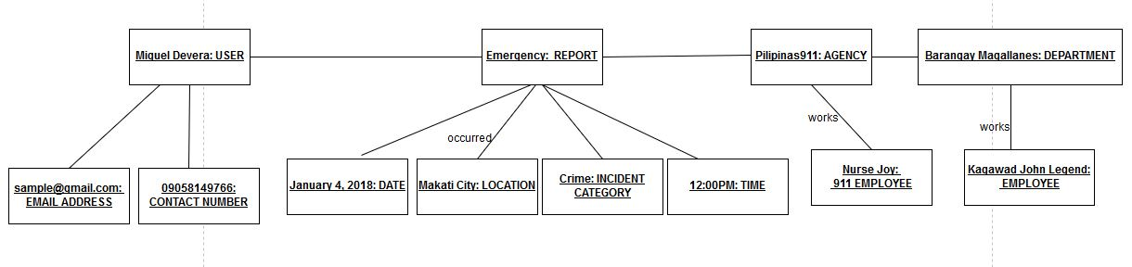
Object Diagram

Slide 40
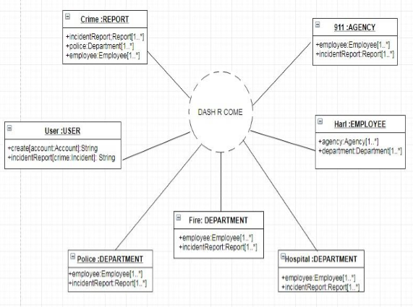
Composite Diagram
Notes:
Harl

Slide 41
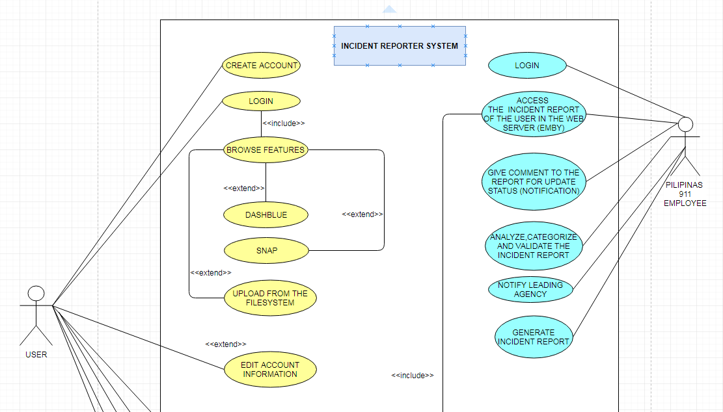
Use Case Diagram
Notes:
Anne

Slide 42
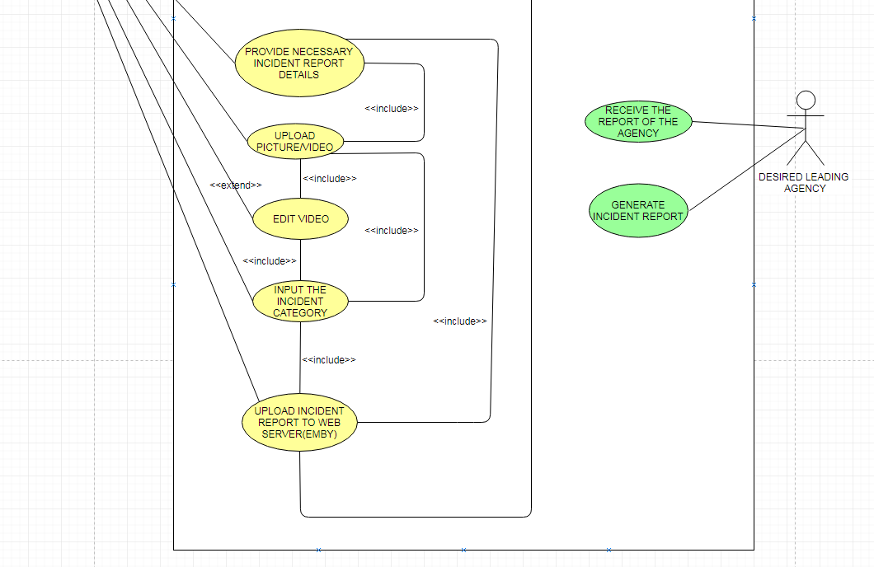
Use Case Diagram
Notes:
Anne

Slide 43
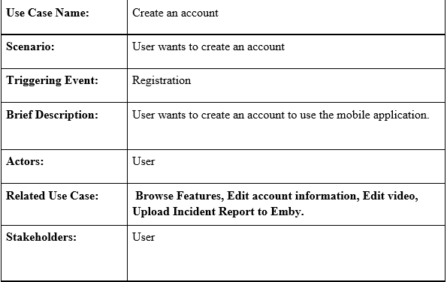
Use Case Full Description

Slide 44
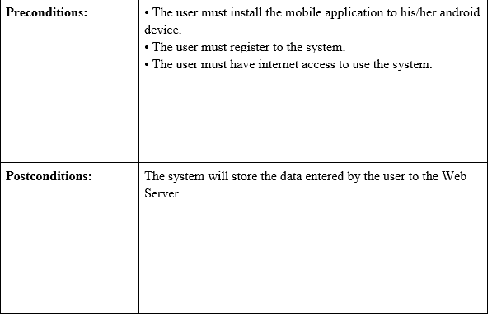
Use Case Full Description

Slide 45
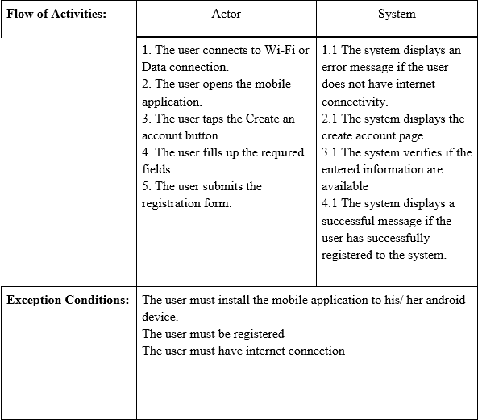
Use Case Full Description

Slide 46
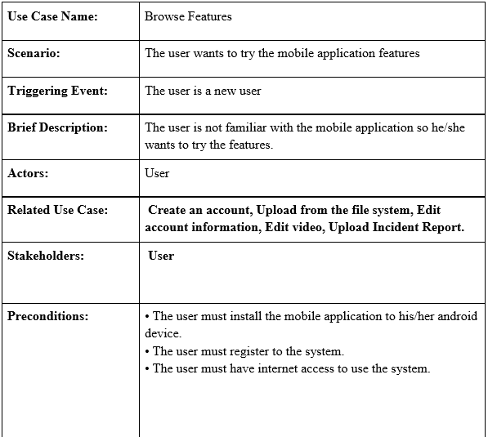
Use Case Full Description

Slide 47
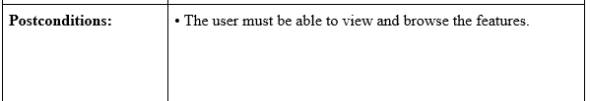

Use Case Full Description

Slide 48

Use Case Full Description

Slide 49

Use Case Full Description

Slide 50


Use Case Full Description

Slide 51


Use Case Full Description

Slide 52

Use Case Full Description

Slide 53


Use Case Full Description

Slide 54

Use Case Full Description

Slide 55

Use Case Full Description

Slide 56

Use Case Full Description

Slide 57

Use Case Full Description

Slide 58


Use Case Full Description

Slide 59

Use Case Full Description

Slide 60


Use Case Full Description

Slide 61

Use Case Full Description

Slide 62


Use Case Full Description

Slide 63

Activity Diagram
Notes:
Anne

Slide 64

Activity Diagram
Notes:
Anne

Slide 65

Sequence Diagram
Notes:
Harl

Slide 66

Sequence Diagram
Notes:
Harl

Slide 67

Sequence Diagram
Notes:
Harl

Slide 68

Sequence Diagram

Slide 69

Deployment Diagram
Notes:
Emman

Slide 70

Deployment Diagram

Slide 71

Deployment Diagram

Slide 72

Communication Diagram

Slide 73

Timing Diagram
Notes:
Emman

Slide 74

Component Diagram
Notes:
Harl

Slide 75

Package Diagram
Notes:
Anne

Slide 76

State Diagram
Notes:
Emman

Slide 77

Interaction Overview Diagram

Slide 78

Interaction Overview Diagram

Slide 79

Interaction Overview Diagram

Slide 80

Interaction Overview Diagram

Slide 81

Interaction Overview Diagram

Slide 82


Slide 83
THANK YOU!

